Slide 1
IB English Language and Literature
6 ELL SL 4
2019 - 2020
Shape of the Week (1):
Lesson 1: Prelim Prep – Essay Writing
Lesson 2: Prelim Prep – Essay Writing
Lesson 3: Prelim Prep – Essay Writing

Slide 2
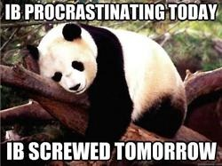

Slide 3


SCHOOL ASSESSMENT TERM 3
☑ PRELIMS!!!

Slide 4
General Outline Term 3
WEEK 1 Paper 2 Prelim Prep
WEEK 2 Paper 1 Prelim Prep
WEEK 3 Prelims
WEEK 4 Prelims
WEEK 5 WT finalisation
WEEK 6 Chronicle
WEEK 7 Chronicle
WEEK 8 Chronicle
WEEK 9 Chronicle

Slide 5


We are still a digital classroom!

Slide 6

English Teacher – CONTACT Details
(copy into homework diary/ notes)
Elisa.Zantos@acsinternational.edu.sg
QUESTIONS/ NOTICES only
https://acs.fireflycloud.asia/
Homework/ Assignments
When you submit digital files, please name file:
familyname.calledname.classname.assignmentname.date
English Assignment ☒
Everdeen.Katniss.1Z.BookPresentation.2May✔

Slide 7


Our School Values…

Slide 8
Be SAFE
Be CIVIL
Be COURTEOUS

Slide 9

Preparation – See Course Companion Checklist
In every class you will need to have:
☑ English Ring File /Binder with dividers*
☑ Notebook*
☑ Homework Diary
☑ Homework Folder
☑ Loose-leaf Foolscap Paper (A4)
☑ Writing Materials
  blue and black pens

Slide 10
Part 3 Learning Outcomes
Consider the changing historical, cultural and social contexts in which particular texts are written and received.
Demonstrate how the formal elements of the text, genre and structure can not only be seen to influence meaning but can also be influenced by context
Understand the attitudes and values expressed by literary texts and their impact on readers

Slide 11
Specifically, students should be given the opportunity to prepare for paper 2, an assessment that incorporates the part 3 texts and constitutes a large part of their overall mark for the course.
Students will be asked to consider not only the social issues inherent in a text (such as gender issues, political issues, conflicts between the individual and society), but also the ways in which the literary devices at work (such as narrative structure, elements of style) could be influencing the meaning of the text..

Slide 12
The paper 2 questions, which are the same for both standard and higher level,
students are free to either compare or contrast their texts, in terms of the questions asked,
Consider the changing historical, cultural and social contexts in which particular texts are written and received.
  Demonstrate how the formal elements of the text, genre, and structure can not only be seen to influence meaning but can also be influenced by context.
  Understand the attitudes and values expressed by literary texts and their impact on readers.

Slide 13
Paper Two: 25%
Both SL and HL students will have a choice of ONE of six questions (same for SL and HL)
The assessment for SL and HL varies not the questions
Students response should reflect their understanding of the Learning Outcomes in Part 3

Slide 14
Paper Two: 25%
Paper 2 requires students to answer one of six questions in a way that reflects their own achievement of the learning outcomes for part 3 of the…paying particular attention to the creation of meaning in those texts via:
1. literary devices
2. historical context
3. critical reception.
Students should also be aware that there is yet another way in which the meaning of the text is created— and it is
4. personal context.

Slide 15

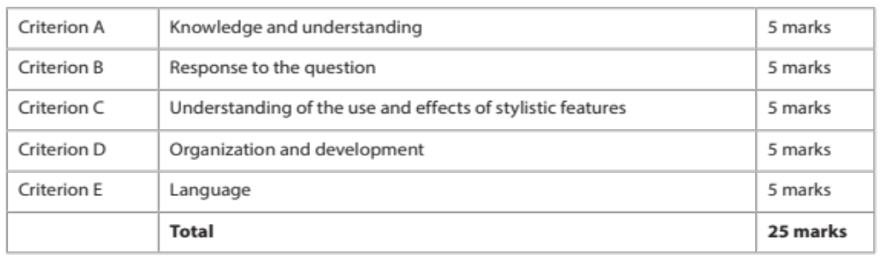
Paper 2 – KEEP EACH OF 5 MARKING CRITERIA IN THE AIR AT ONCE!

Slide 16


Compulsory

Slide 17

Recommended: Dystopian Literature
Utopia - Moore
The Hunger Games - Collins
Animal Farm - Orwell
Brave New World – Huxley
Road to Wigan Pier/Such, Such Were the Joys – Orwell http://george-orwell.org/search.php?query=&book=198
The Handmaid’s Tale - Atwood

Slide 18
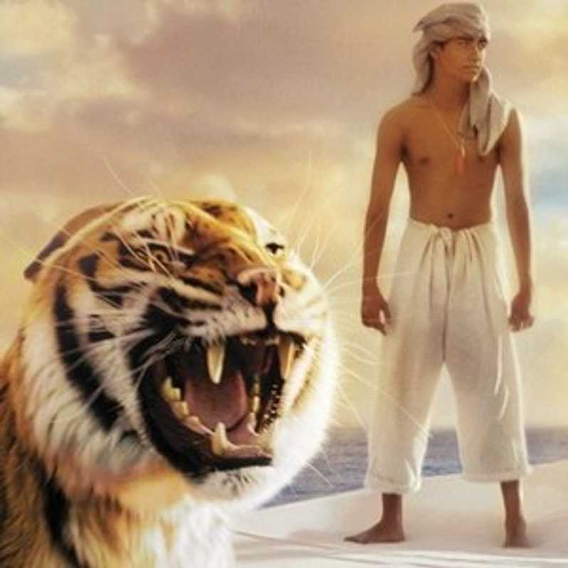
Recommended: Magical Realism Literature
Life of Pi - Martel
Chocolat- Harris
Like Water for Chocolate - Esquival
Love in the Time of Cholera - Marquez
Beloved- Morrison
Midnight’s Children – Rushdie
The God of Small Things- Roy

Slide 19



History – Recommended Reading
Check school library before buying on Amazon or similar!

Slide 20

Remember!
Orwell dies in January of 1950. X P
Do NOT discuss events/ ideas about the Cold War that come AFTER this.
DO discuss events/ ideas from the Second World War (ends 8 August 1945).

Slide 21


Communication – Response Model
Language used
to create
meaning
Medium (text type)
Genre
Social Purpose
Theme
Ideas and values promoted
Style
Structure
Communication Process
Composer or producer of the text.
Context 1 - the immediate social, cultural and historical circumstances of the composition.
Responder or interpreter of text.
Context 2: the immediate social, cultural and historical circumstance of reception.
Meanings

Slide 22
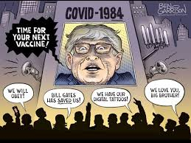
Context of Reception – easy for Orwell in 2020

Slide 23
Paper 2 – KEEP EACH OF 5 MARKING CRITERIA IN THE AIR AT ONCE!

Slide 24

Comparative Analysis Essay
This is the type of essay. This is made more difficult for you because you are comparing and analysing TWO - texts, against THREE dimensions. You must address:
The Literary Theme or Concept of Question:
  This is an examination of one of the aspects of a literary theme or concept, introduced by the question.
Context of both texts’ production (reception+):
  This relates to how the theme/ concept as understood, interpreted and produced by the composer for a contemporary audience.
Techniques/ Devices used to make meaning about the concept or theme.
  This provides evidence of your claim in the point above – how has the composer expressed their ideas about the literary concept or theme to the reader.

Slide 25
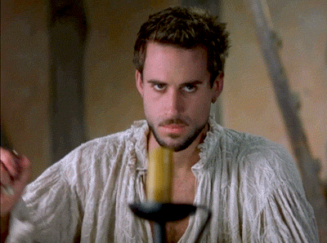
Structure of the Essay
It is best to think about this before-hand.
All essays will have:
An introduction (duh)
A body
  context paragraphs
  PETEL paragraphs
A conclusion (duh)

Slide 26
Thematic vs Conceptual Questions
On the next slide, let’s identify which is which!

Slide 27
Something to get you thinking...
What types of themes might we encounter on the exam?
What types of literary concepts might we encounter on the exam?

Slide 28
1. Analyse how justice is represented and understood in at least two works studied.
Thematic
2. Writers often use a character who is alienated from his or her culture or society in order to explore cultural or social values. Examine this idea with reference to at least two works studied.
Conceptual
3. What impact does setting have on your understanding of the central ideas or themes presented in at least two works studied?
Conceptual
4. Literature is often said to be timeless. To what extent is this true of at least two works you have studied?
Conceptual
5. It has been said that history “cannot be unlived, but if faced with courage, need not be lived again.” To what extent do at least two works studied “face” history in order to ensure that its wrongs “need not be lived again”?
Conceptual (more towards the plot)
6. Looking closely at at least two works studied, show that more than one interpretation could be made of those works. (conceptual)

Slide 29

Brainstorm!
With a friend/ friends: brainstorm several examples of themes and literary concepts that we might encounter on the exam. Remember that they should be relevant to a great many texts but general.
Add your examples to the spider diagrams. Remember to add your initials of the pair/ group.
Critically examine the contributions of others.

Slide 30
Open – Unpacking Questions DOC.
Go to Firefly!

Slide 31
Brainstorm!
Try it for Orwell!
"How are characters alienated from society in at least 2 works that you have read?”
examine all of the implications of a particular question
apply the implications of the question to the literary works you've read.
Spider diagram!

Slide 32


Homework

